Slide 1

Schema Decomposition Algorithms
Database Management System | Database Design and Advanced Normalization
Course: Database Management System | Chapter: Database Design and Advanced Normalization | Program: Bachelor of Engineering
DISCOVER · LEARN · EMPOWER
Notes:
Welcome everyone to today's lecture on Schema Decomposition Algorithms. We are diving deep into the core of database design to ensure our structures are robust. Remember, the goal is to transform complex schemas into efficient, normalized forms. Let's begin our journey into Discover. Learn. Empower.

Slide 2
Course Outcomes
SLIDE 2 / 14
Course Outcome
CO | BT LEVEL | DESCRIPTION
CO1 | BT2 | Explain database architecture, relational model concepts and formal query language foundations including relational algebra and relational calculus.
CO2 | BT3 | Apply relational algebra, relational calculus and SQL constructs to formulate correct and efficient database queries.
CO3 | BT4 | Analyze functional dependencies and design normalized relational schemas up to 5NF ensuring lossless join and dependency preservation.
CO4 | BT4 | Analyze transaction schedules and concurrency control mechanisms to determine serializability, recoverability and correctness.
CO5 | BT5 | Evaluate storage structures, indexing strategies and query optimization techniques for performance, scalability and reliability.
Chandigarh University
2 / 14
Notes:
Today's session directly addresses our first two course outcomes. We will explain the architectural foundations of decomposition algorithms under CO1. Simultaneously, we will apply these concepts to formulate efficient query structures as required by CO2. These outcomes are the backbone of our design skills.

Slide 3
Learning Objectives
SLIDE 3 / 14
Learning Outcomes
1
Define the necessity of schema decomposition in database design.
2
Analyze the properties of lossless join and dependency preservation.
3
Apply the synthesis algorithm to convert relations into 3NF.
4
Evaluate the trade-offs between normalization and query performance.
5
Demonstrate decomposition using a concrete numerical example.
Chandigarh University
3 / 14
Notes:
By the end of this lecture, you will be able to define why we decompose schemas. You will analyze critical properties like lossless joins. We will apply the synthesis algorithm to real-world scenarios. Finally, you will evaluate the performance trade-offs involved in these designs.

Slide 4
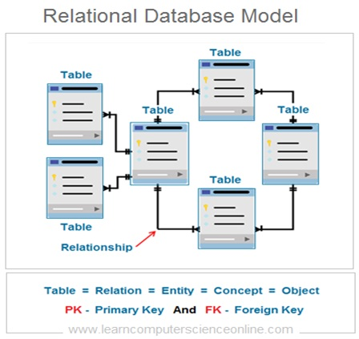
Lecture
SLIDE 4 / 14
Why Decompose Schemas?
1
Decomposition splits large relations into smaller, manageable sub-relations.
2
It eliminates data redundancy and prevents update anomalies.
3
It improves data integrity by isolating specific functional dependencies.
4
It enhances query performance by reducing the scan area.
5
It facilitates better concurrency control in multi-user environments.
Relational Database | Learn Relational Database Model RDBMS
Chandigarh University
4 / 14
Notes:
Imagine a massive table where changing a professor's name requires updating hundreds of rows. This is redundancy. Decomposition solves this by splitting the table. It isolates dependencies so that one change does not ripple through the entire dataset. This is the fundamental reason we design schemas this way.

Slide 5
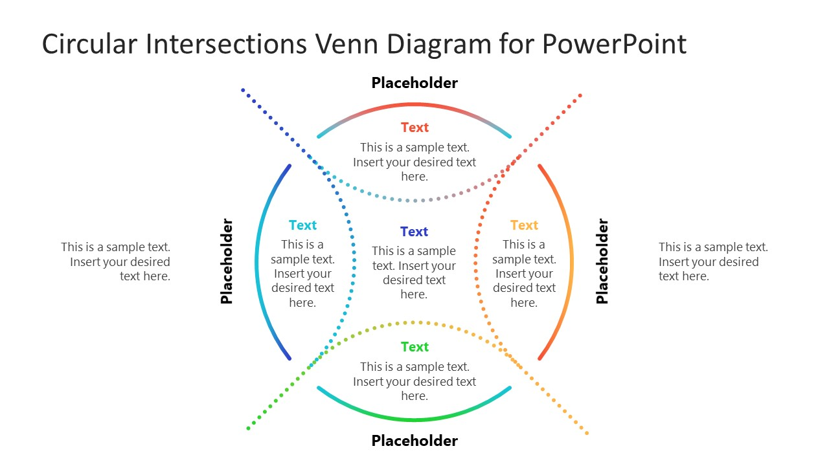
Lecture
SLIDE 5 / 14
Lossless Join Property
MATHEMATICALLY
R1 ∩ R2 must functionally determine R1 or R2.
• A decomposition is lossless if the natural join recovers the original relation.
• No spurious tuples are generated during the reconstruction process.
• The intersection of decomposed relations must be a superkey of one.
• Without this property, data integrity is compromised permanently.
Source: slidemodel.com
Chandigarh University
5 / 14
Notes:
The lossless join property ensures we do not lose information. If we split a table, we must be able to join them back perfectly. The intersection of the two new tables must act as a key. Otherwise, we get spurious tuples that look like real data but are not.

Slide 6
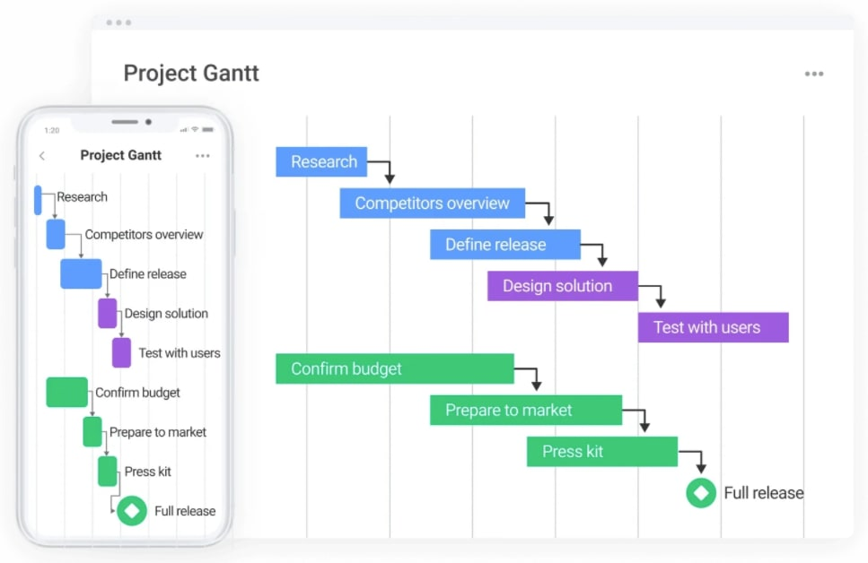
Lecture
SLIDE 6 / 14
Dependency Preservation
1
All functional dependencies must be enforceable on the decomposed relations.
2
Checking constraints should not require joining multiple tables.
3
It ensures data integrity checks remain efficient and local.
4
If a dependency spans relations, it is not preserved.
5
3NF guarantees dependency preservation for all functional dependencies.
Source: res.cloudinary.com
Chandigarh University
6 / 14
Notes:
Dependency preservation means we can check constraints without joining tables. If a rule like 'A determines B' is split across two tables, we must join them to verify it. This is expensive. 3NF ensures all rules are preserved within individual tables for efficiency.

Slide 7
Lecture
SLIDE 7 / 14
Synthesis Algorithm Overview
1
Start with a minimal cover of the functional dependencies.
2
Group dependencies that share the same left-hand side attribute.
3
Create a relation for each group of dependencies.
4
Ensure the key of the original relation is present in a relation.
5
The result is always in 3NF with dependency preservation.
Chandigarh University
7 / 14
Notes:
The synthesis algorithm is a systematic approach to 3NF design. We start by finding a minimal cover of our dependencies. Then we group them by the left-hand side. Each group becomes a new table. This guarantees a lossless join and dependency preservation.

Slide 8
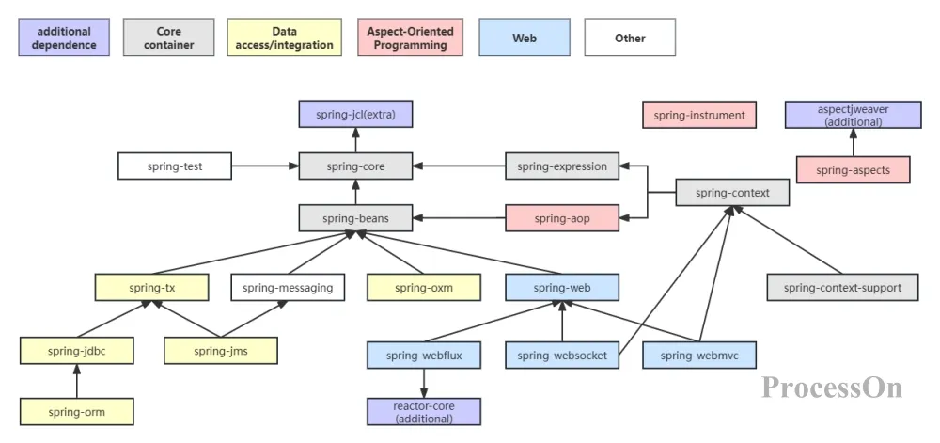
Step 1
SLIDE 8 / 14
Minimal Cover
1
Eliminate redundant functional dependencies from the set.
2
Reduce the right-hand side to a single attribute.
3
Remove extraneous attributes from the left-hand side.
4
A minimal cover is unique in terms of closure.
5
This step simplifies the algorithm before grouping relations.
Source: cdn.processon.io
Chandigarh University
8 / 14
Notes:
Before grouping, we must simplify. We remove redundant rules and extraneous attributes. For example, if A determines B and B determines C, A determines C is redundant. We strip this down to the essential rules. This minimal cover is the foundation of our design.

Slide 9
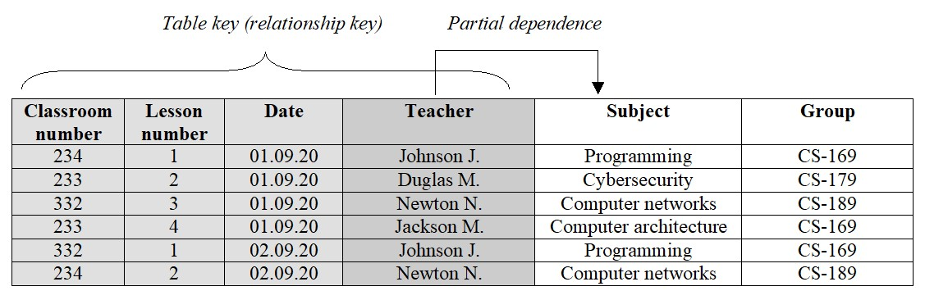
Step 2
SLIDE 9 / 14
Grouping Dependencies
1
Collect all dependencies with the same left-hand side attribute.
2
Form a relation schema from the left-hand side and right-hand side.
3
Each group forms a candidate relation in the final schema.
4
Attributes appearing only on the right-hand side are included.
5
This creates the core set of normalized relations.
Source: www.bestprog.net
Chandigarh University
9 / 14
Notes:
Now we group the simplified dependencies. If A determines B and C, we create a relation with A, B, and C. We do this for every unique determinant. This creates the core set of tables. Each table represents a specific functional dependency cluster.

Slide 10
Step 3
SLIDE 10 / 14
Key Verification
1
Identify the candidate key of the original relation.
2
Check if the key appears in any of the generated relations.
3
If not, create a new relation containing only the key attributes.
4
This ensures the lossless join property is maintained.
5
The final schema includes all generated relations plus the key.
Chandigarh University
10 / 14
Notes:
We must ensure the original key is preserved. If the key does not appear in any of our generated tables, we add a new table for it. This step is crucial for the lossless join property. Without it, we might lose the ability to reconstruct the original data.

Slide 11
Worked Example
SLIDE 11 / 14
Setup
DEPENDENCIES
A→B, B→C, C→D, D→E, E→A.
• Relation R(A, B, C, D, E) with functional dependencies.
• We need to decompose R into 3NF using synthesis.
• First, find the minimal cover of these dependencies.
• Note that A is a candidate key for the whole relation.
Chandigarh University
11 / 14
Notes:
Let's apply this to a concrete example. We have a relation with five attributes and a cycle of dependencies. A determines B, B determines C, and so on. A is a candidate key. We will walk through the synthesis steps to normalize this specific schema.

Slide 12
Worked Example
SLIDE 12 / 14
Execution
MINIMAL COVER YIELDS
A→B, B→C, C→D, D→E, E→A.
• Group 1: A→B creates relation R1(A, B).
• Group 2: B→C creates relation R2(B, C).
• Group 3: C→D creates relation R3(C, D).
• Group 4: D→E creates relation R4(D, E).
Chandigarh University
12 / 14
Notes:
We group the dependencies. A determines B, so we get R1. B determines C, so we get R2. We continue this for C and D. We end up with four relations. Each relation captures a specific dependency. This is the core of the synthesis process.

Slide 13
Lecture
SLIDE 13 / 14
Key Takeaways
1
Schema decomposition eliminates redundancy and update anomalies.
2
Lossless join ensures no data is lost during reconstruction.
3
Dependency preservation allows efficient constraint checking.
4
Synthesis algorithm guarantees 3NF with dependency preservation.
5
Always verify the original key is present in the schema.
Chandigarh University
13 / 14
Notes:
To summarize, decomposition is essential for robust database design. We must ensure lossless joins and dependency preservation. The synthesis algorithm is a reliable method to achieve 3NF. Always remember to check that the original key is preserved in your final schema.

Slide 14
Lecture
SLIDE 14 / 14
References
1
Fundamentals of Database Systems — Ramez Elmasri & Shamkant B. Navathe
2
Database System Concepts — Silberschatz, Korth & Sudarshan
3
Database Management Systems — Raghu Ramakrishnan & Johannes Gehrke
4
Oracle/MySQL Documentation — Oracle
Chandigarh University
14 / 14
Notes:
These are the standard texts for our course. Elmasri and Navathe provide a comprehensive foundation. Silberschatz offers deep theoretical insights. Ramakrishnan and Oracle documentation provide practical implementation details. Please refer to these for further study.

